Slide 1
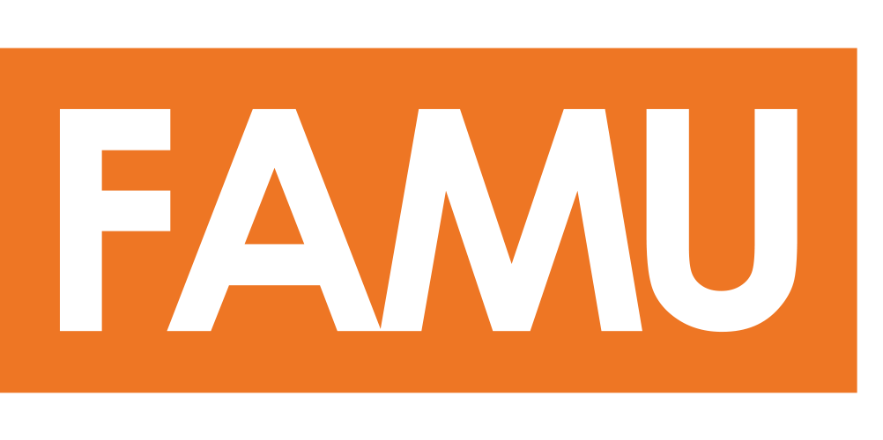
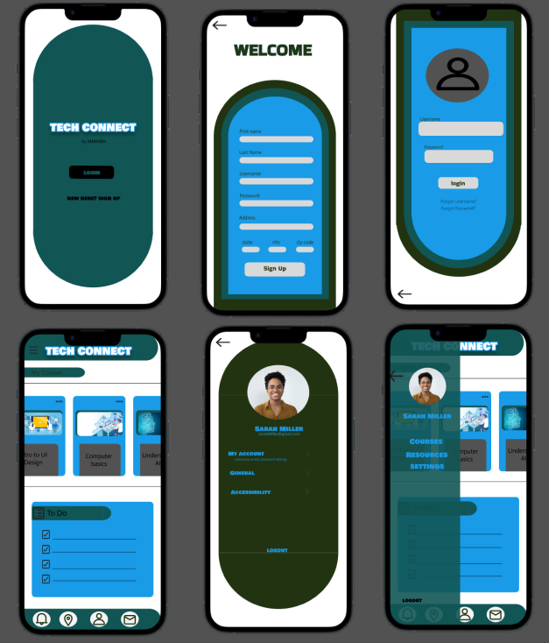
Throughout the process of designing and implementing the Tech Connect application, we gained valuable insights into project planning, risk management, and user-centric design. These experiences enhanced our ability to effectively organize project tasks, mitigate potential risks, and prioritize user needs and preferences in the application's development.
TechConnect by MMW&N
Keisha Moreau, Woodhans Joseph, Reynold Monestine & Kameron NorWood
Introduction
Wireframes
Process
The TechConnect project addresses the business need to bridge the gap between underprivileged communities and valuable resources, mentorship, and educational opportunities in technology. The project aims to empower individuals and enhance their skills and opportunities in the tech industry by providing access to mentors, resources, and tech-related courses.
The wireframes encompass the onboarding screen, signup screen, login screen, dashboard, profile page, and dashboard with an open sidebar.
Designing the TechConnect application involved several strategic steps to meet the project's objectives and scope effectively.
Initially, we developed a comprehensive project charter outlining the project's scope, objectives, deliverables, and business justification. In addition to the project charter, we established budget and time estimates, conducted a SWOT analysis, and formulated a team contract that defined expectations for all team members.
After conducting research on existing systems and APIs, such as Qooper for mentorship features and Twilio for in-app messaging, we identified functional and non-functional requirements aligned with our business objectives. Afterwards, we created a Work Breakdown Structure, use cases, and Gantt charts based on the gathered requirements.
Following the requirements gathering and planning phase, we proceeded to design the user interface (UI) by developing a comprehensive style guide and interactive wireframes.
Finally, we created a risk register to identify and manage potential project risks, along with a data dictionary to define and document the project's data elements and their attributes.
Technology
Technologies utilized during our project included a diverse range of tools and frameworks tailored to our development needs.
Github - utilized for facilitating collaboration among team members and for creating project milestones
Figma - employed for creating interactive wireframes
Project365 - utilized to create the Work Breakdown Structure (WBS) and Gantt charts for the project.
APIs we intend to utilize
Qooper API - a mentorship and professional development platform that facilitates mentor matching, networking, and skill development.
LinkedIn Learning API - an online platform offering a vast library of courses and tutorials covering various topics
Google Maps API - enable the integration of mapping and geolocation functionalities
Twilio -facilitate messaging, notifications, and email functionalities
WordPress REST API - facilitate the management and delivery of dynamic content
Firebase Authentication - manage user authentication and authorization processes
Conclusion
Throughout the process of designing and implementing the TechConnect application, we gained valuable insights into project planning, risk management, and user-centric design. These experiences enhanced our ability to effectively organize project tasks, mitigate potential risks, and prioritize user needs and preferences in the application's development.

